Slide 1
SusDonate
Kyra Coffie, Kurt Dahl, Amar Javaid, Devin Sparrow & Neha Wadhwani

Slide 2
SusDonate
Our mission is to create a charitable marketplace that rewards sustainability. SusDonate encourages environmentally-conscious choices through award points. These accumulated points are converted to dollars that can then be donated charities.

Slide 3
susDONATE APPLICATION INTERFACE
Tracks the actions of users who voluntarily change their habits to be environmentally friendly and the impacts of those actions in terms of CO2 and dollars saved
Tracks the donation amounts distributed to charities
Provide data to corporations to encourage changes with their sustainability processes

Slide 4
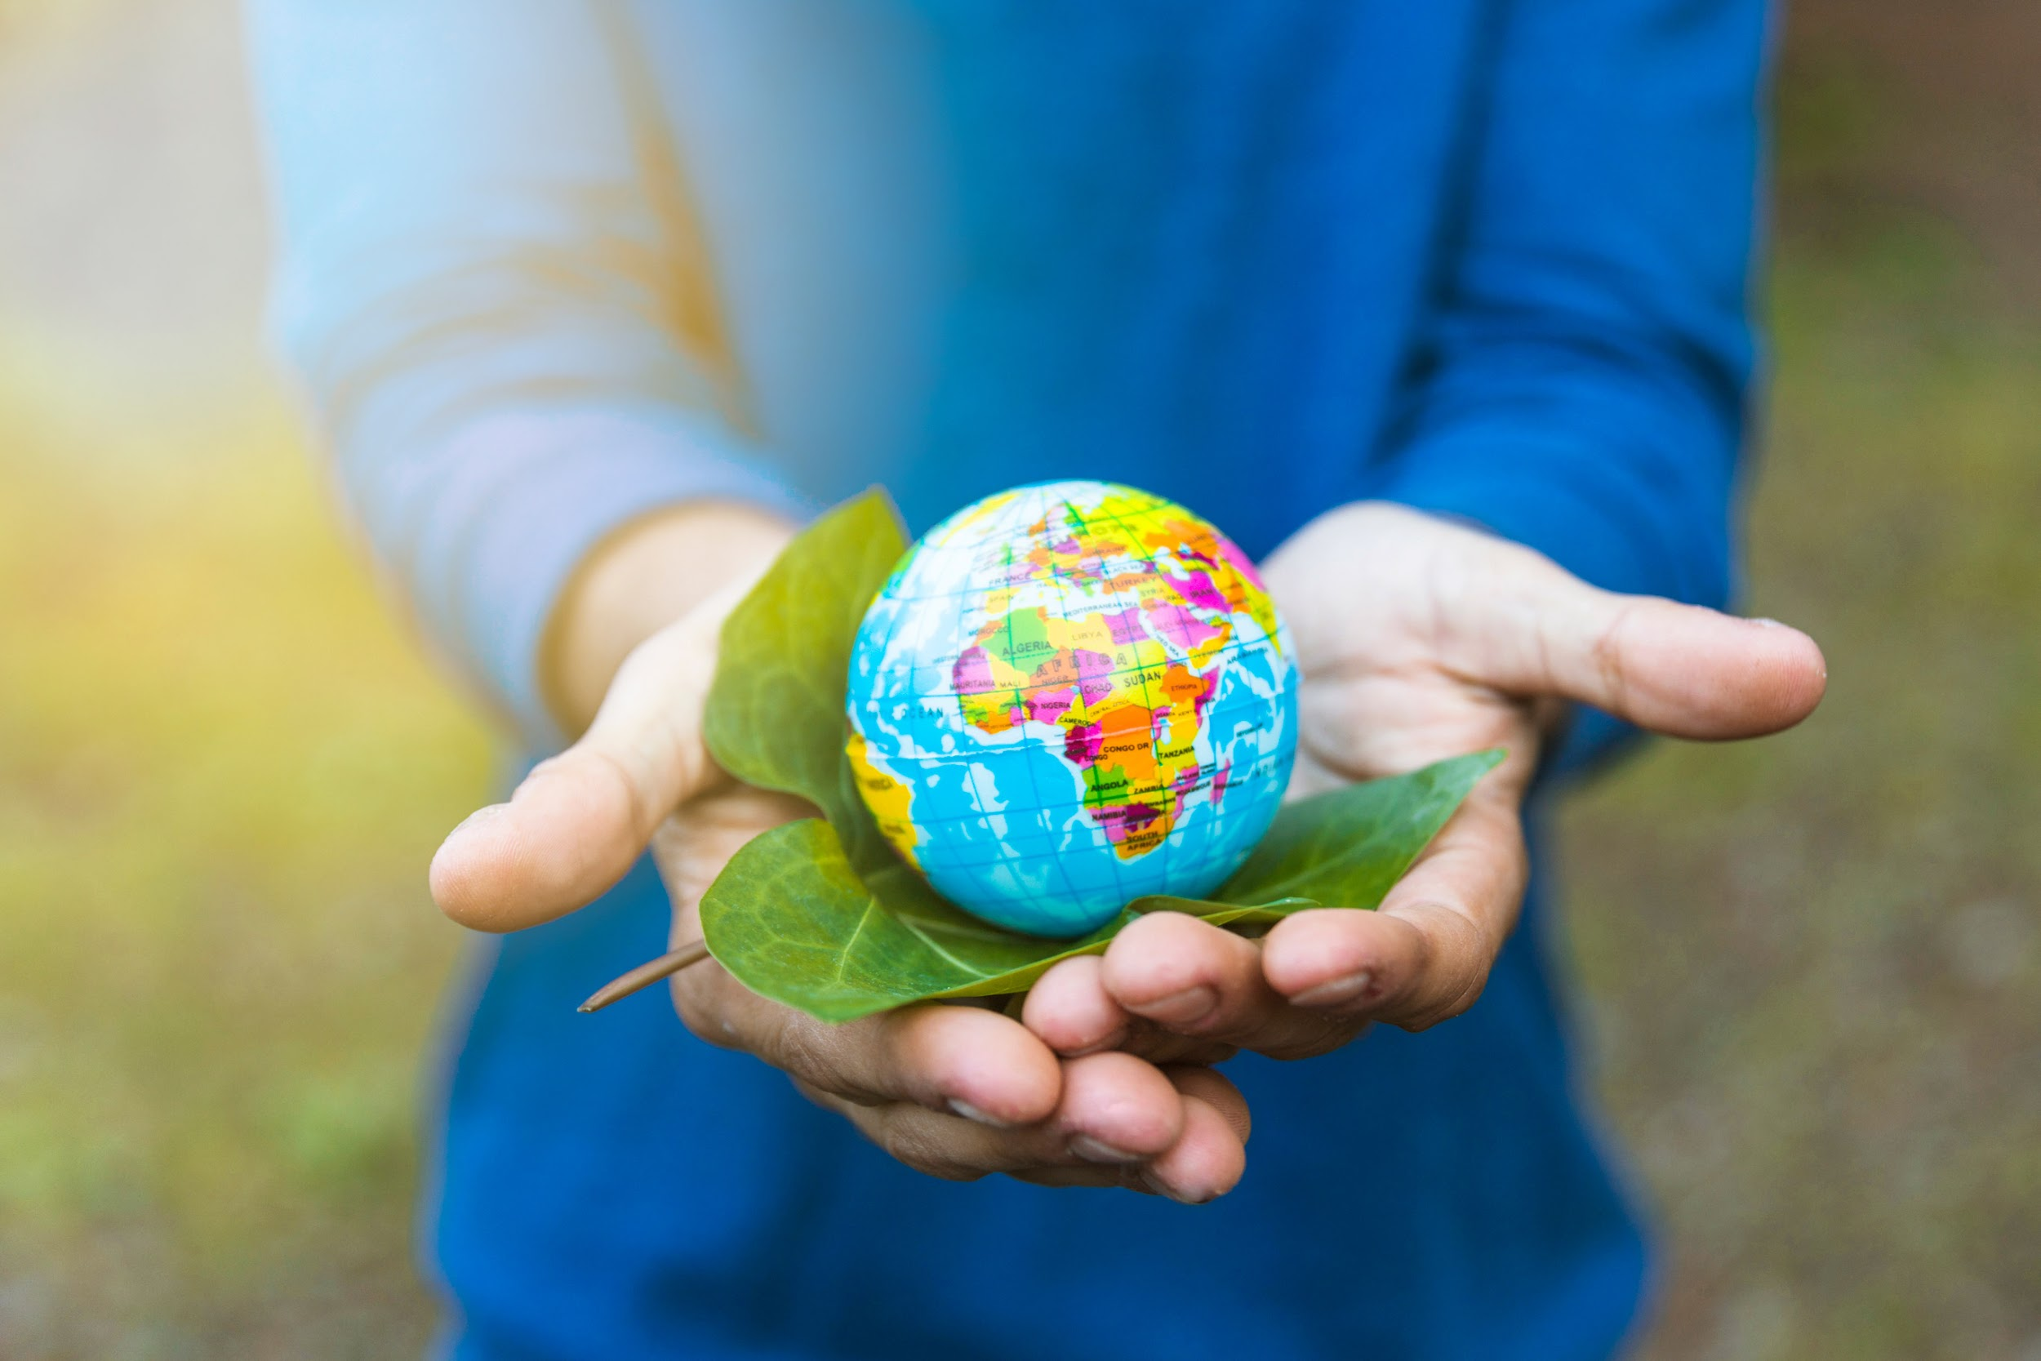
NO CHALLENGE POSES A GREATER THREAT TO FUTURE GENERATIONS THAN CLIMATE CHANGE.
President Obama

Slide 5
TWO SIDES OF CLIMATE CHANGE
95% PROBABILITY
ACTIONS ADD UP
Human-produced greenhouse gases has contributed to an increase in Earth’s rising temperatures
Investing in energy-efficient appliances, LED light bulbs & reducing “idle loads” decreases greenhouse gases.
OCEAN WARMING
WATER IS LIFE
The ocean has absorbed 90% of the increased heat from climate change.
Shorter showers, water-efficient fixtures & turning off the tap while brushing your teeth reduces carbon pollution.
https://climate.nasa.gov/, https://www.nrdc.org/stories/how-you-can-stop-global-warming

Slide 6
OUR AUDIENCE
Highly-Motivated
Moderately-Motivated
Not Interested
Motivated to arrest climate change
Aggressively monitors their carbon footprint & environmental impact
Actively researches ways to be sustainable
Patronizes companies with eco-friendly business practices
Believes climate change is important
Recycles when possible
Volunteers at community clean up days
Tries to set a positive example for their family
Wants to be part of the solution but doesn’t always know how
Believes earth is in a natural warming phase
Thinks science could be wrong
Doesn’t think about sustainability or protecting the environment
Skeptical that a single person can’t make a big difference
“ If everyone does one small thing, it can add up to a big difference that will make impactful changes for our communities, countries and eventually the world”.
“ I want to be 100% committed to sustainability but sometimes it can be a lot of work. Why can’t saving the planet be a little easier?”
“Climate change isn’t real and eventually scientists are going to come back and say it wasn’t a big deal. I don’t think there is anything to worry about”.

Slide 7
DATA FLOW
Information flowing through our application

Slide 8
ACTIONS, SAVINGS AND CHARITIES
ACTIONS
SAVINGS
CHARITIES
Users can make two types of actions: individual and consumer oriented. They are manually inputted or QR codes are used.
Those actions, combined with company awards, save cash and the planet.
Users donate their accumulated funds to the charities of their choice.

Slide 9
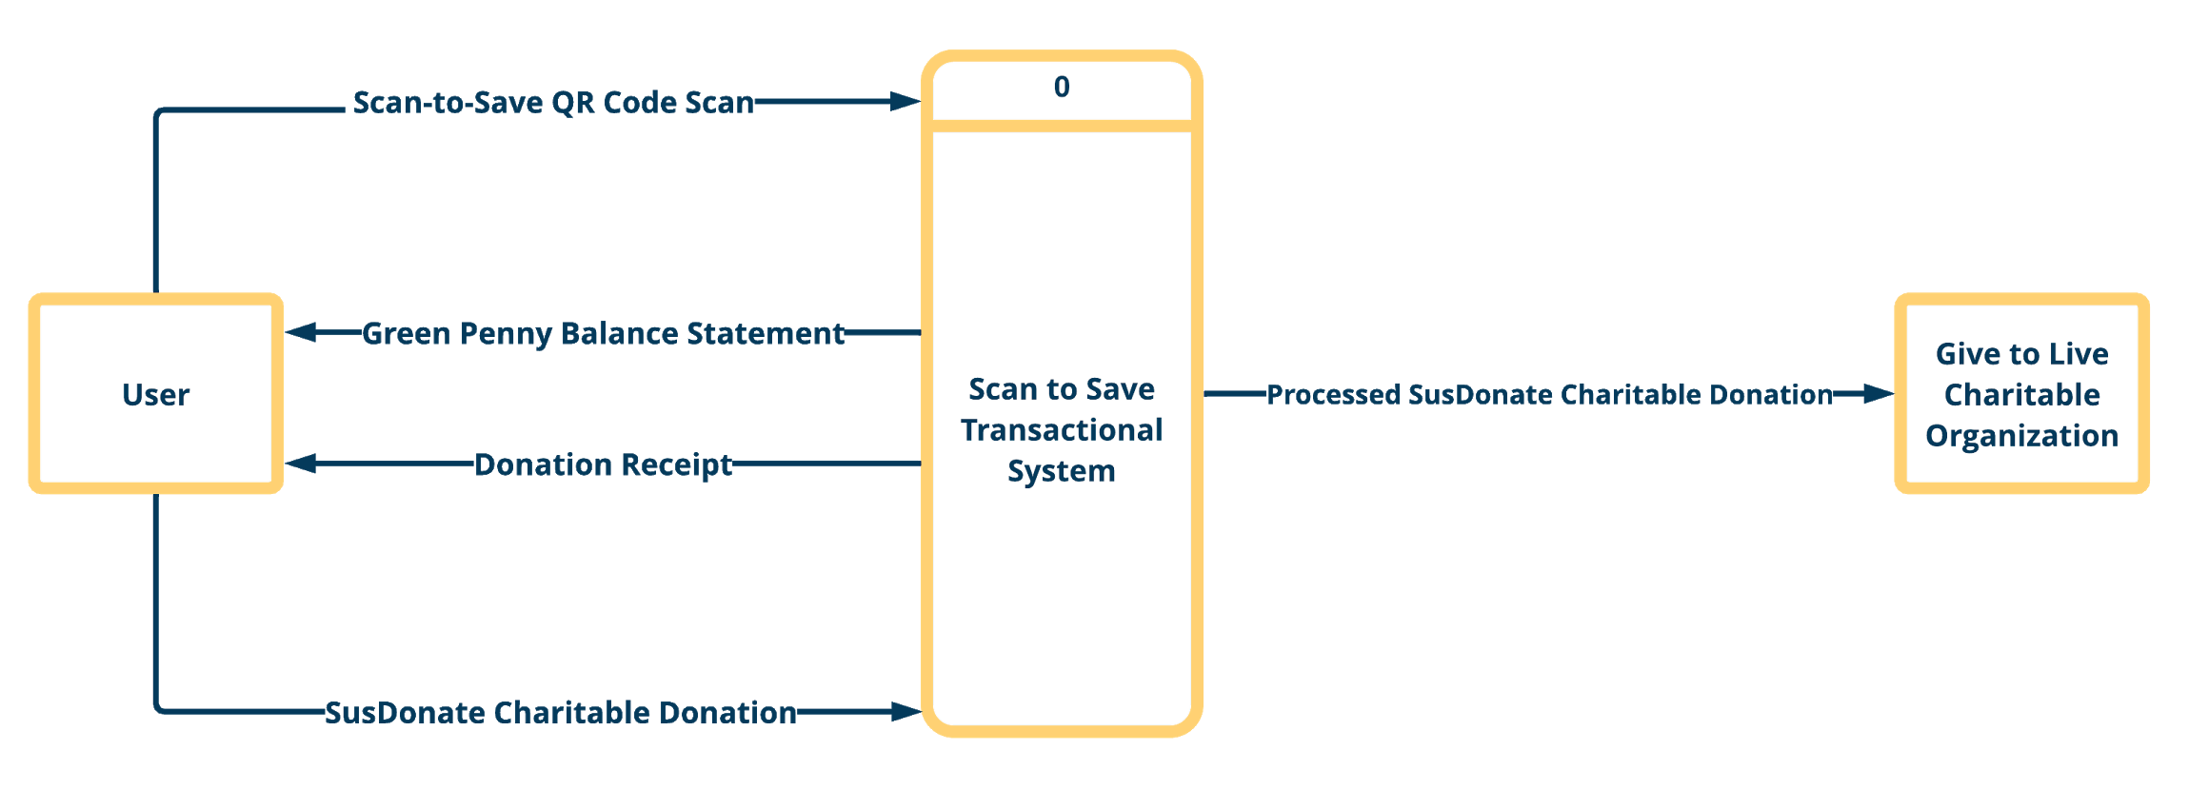
SCAN-TO-SAVE CONTEXT DIAGRAM

Slide 10
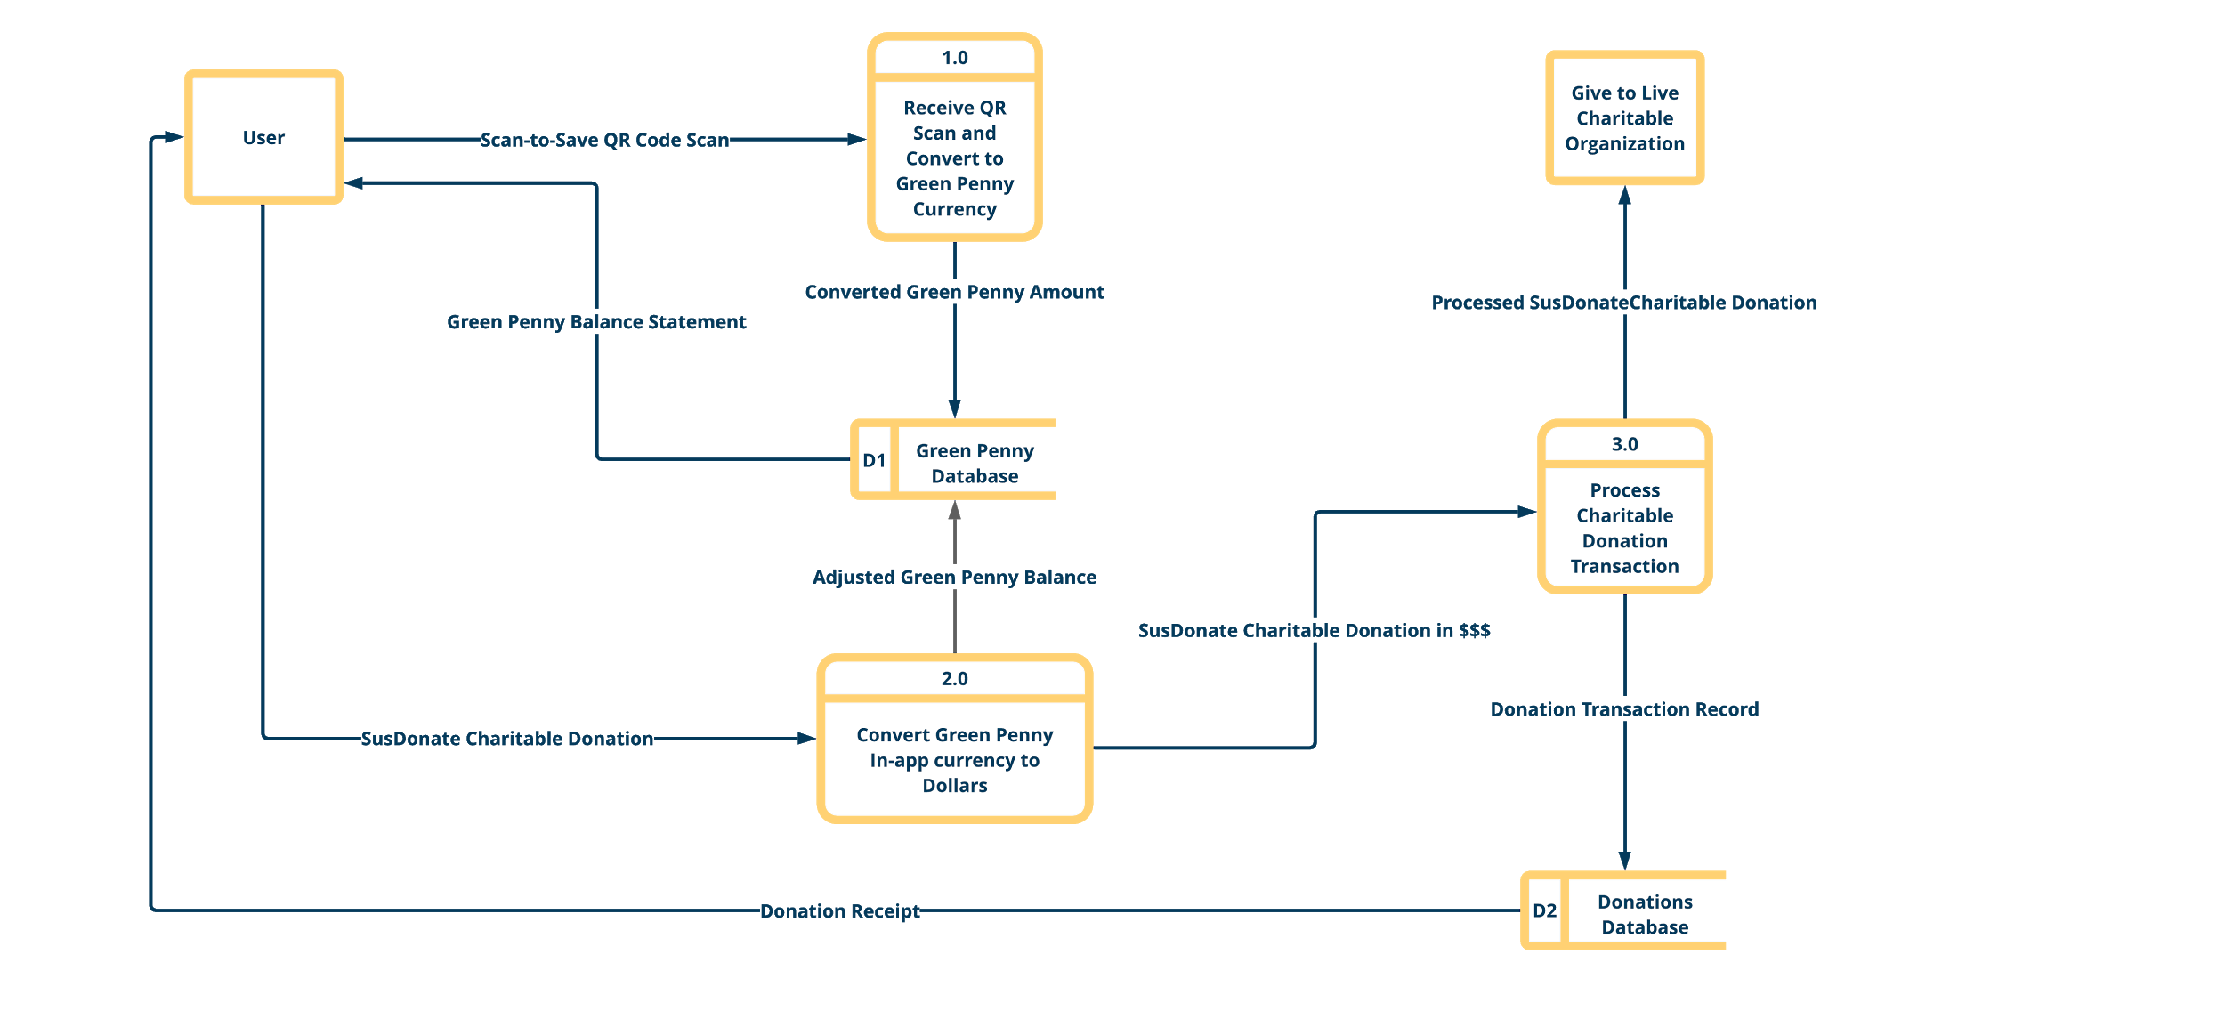
SCAN-TO-SAVE LEVEL 1 DIAGRAM

Slide 11
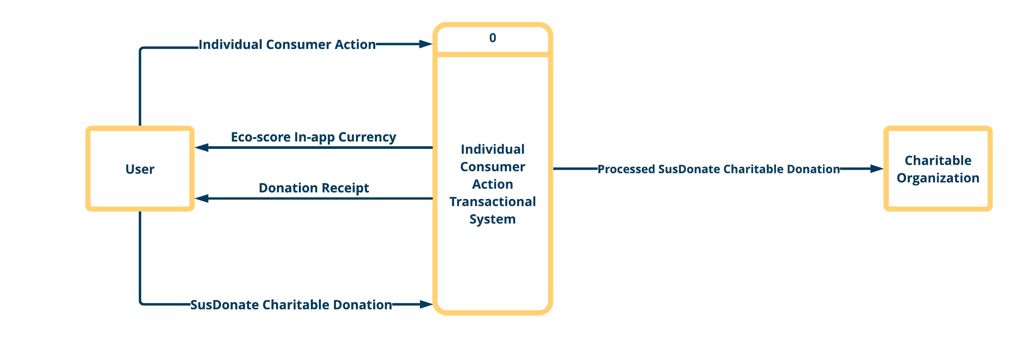
INDIVIDUAL CONSUMER ACTION CONTEXT DIAGRAM

Slide 12
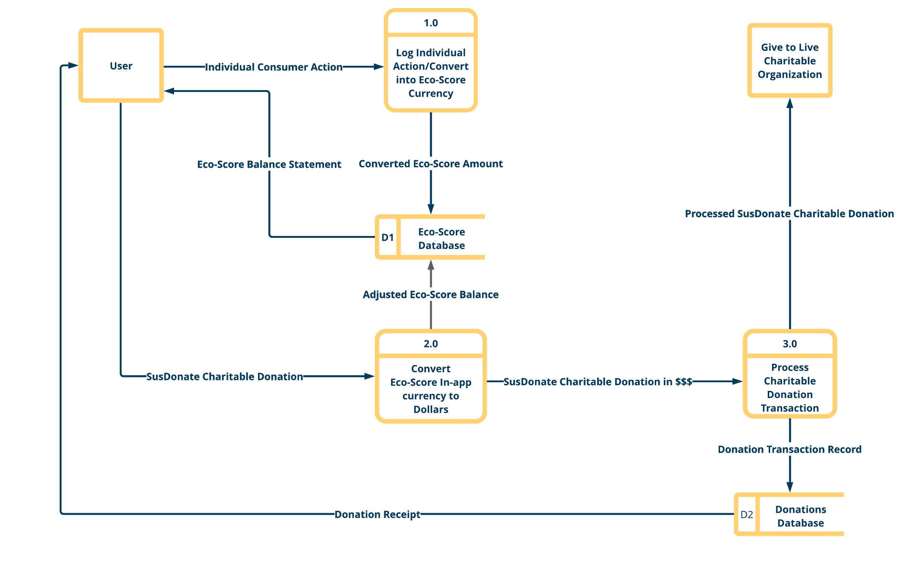
INDIVIDUAL CONSUMER ACTION LEVEL 1 DIAGRAM

Slide 13
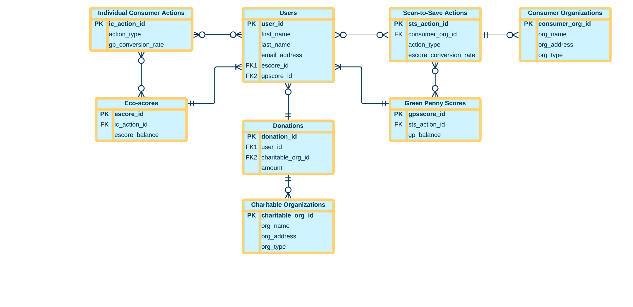
susDONATE ENTITY RELATIONSHIP DIAGRAM

Slide 14
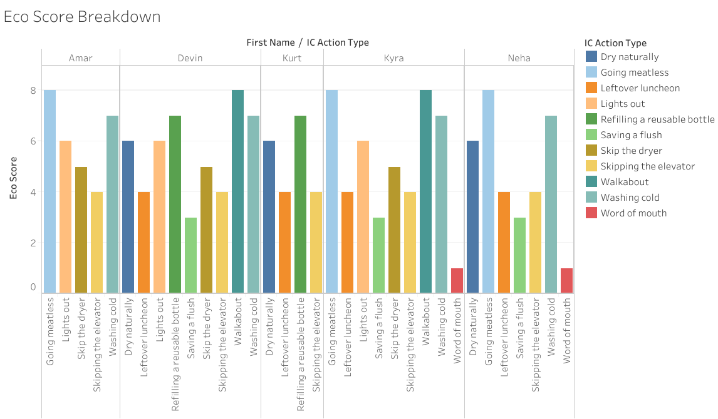
SusDONATE:ECO SCORE
The user tracks their individual actions within the
app & those actions generate an ECO SCORE
Notes:
Don’t forget to mention that these are voluntary dollars being added to the application. Should we mention that maybe it’s linked to a bank account or something?

Slide 15
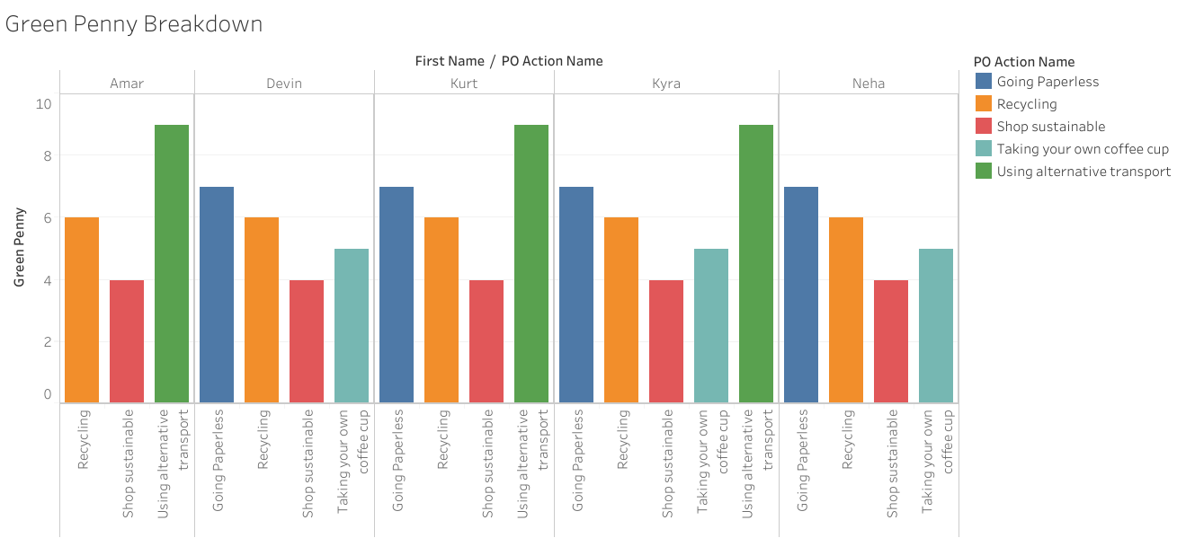
SusDONATE:GREEN PENNY
The user tracks their consumers actions within the
app & those actions accumulate GREEN PENNY points

Slide 16
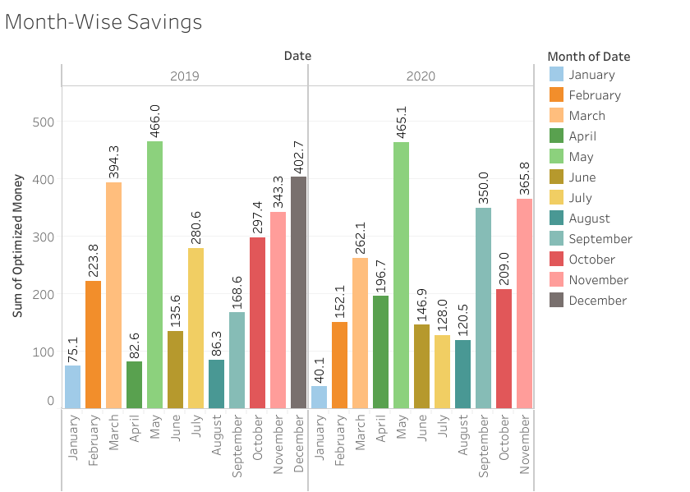
SusDONATE: ACCUMULATED FUNDS
GREEN PENNIES and the ECO SCORE monies
are combined for later distribution to a charity.

Slide 17
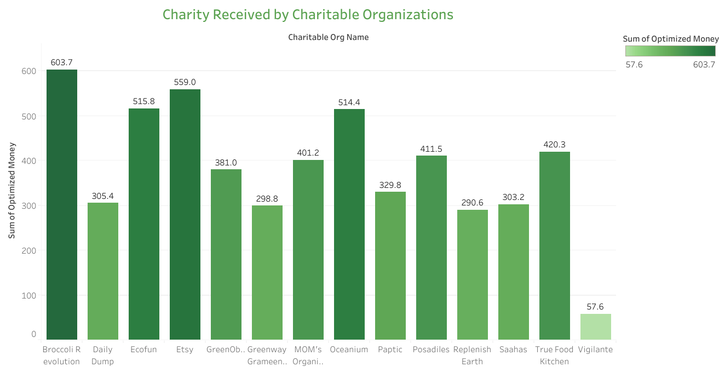
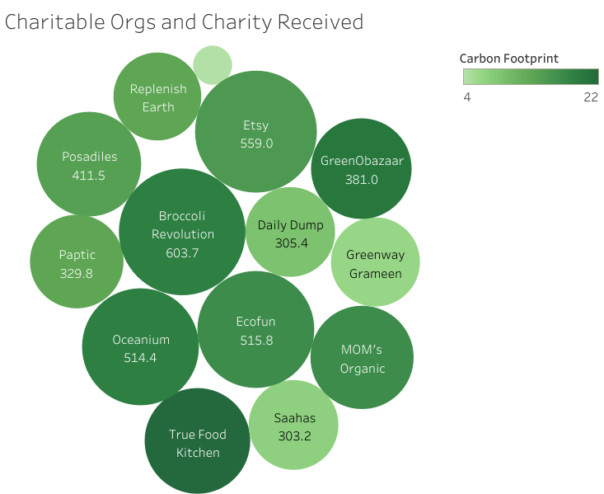
SusDONATE: ACCUMULATED FUNDS
GREEN PENNIES and the ECO SCORE accumulated monthly savings are donated to charities within the app

Slide 18
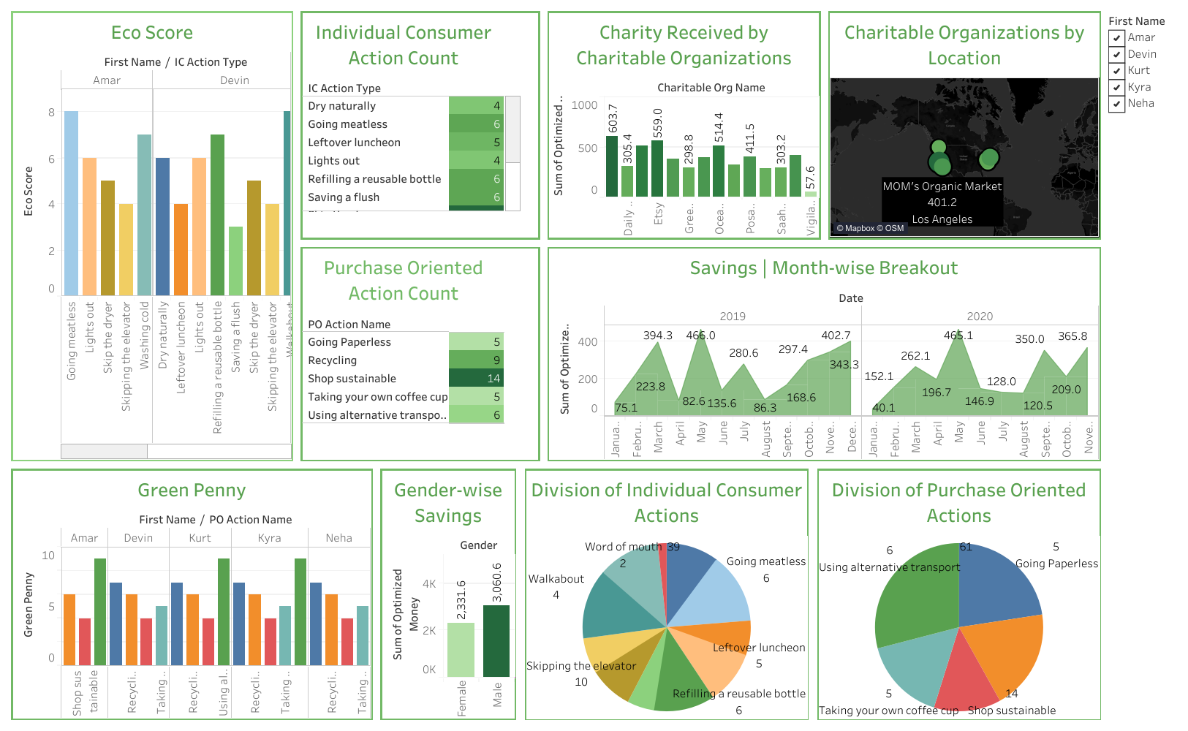
SusDONATE
DASHBOARD
Allows different interpretations of the data such as gender and charity locations.

Slide 19
susDONATE RENDERINGS

Slide 20
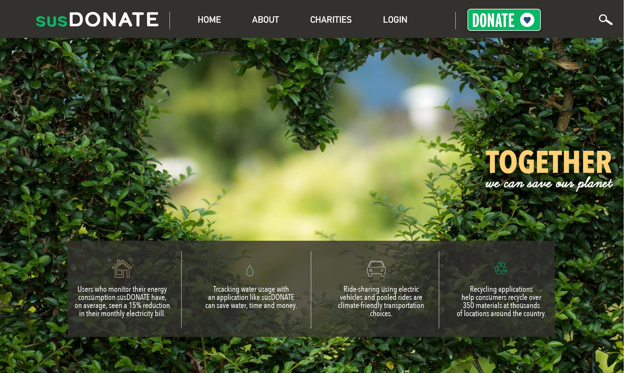

Slide 21
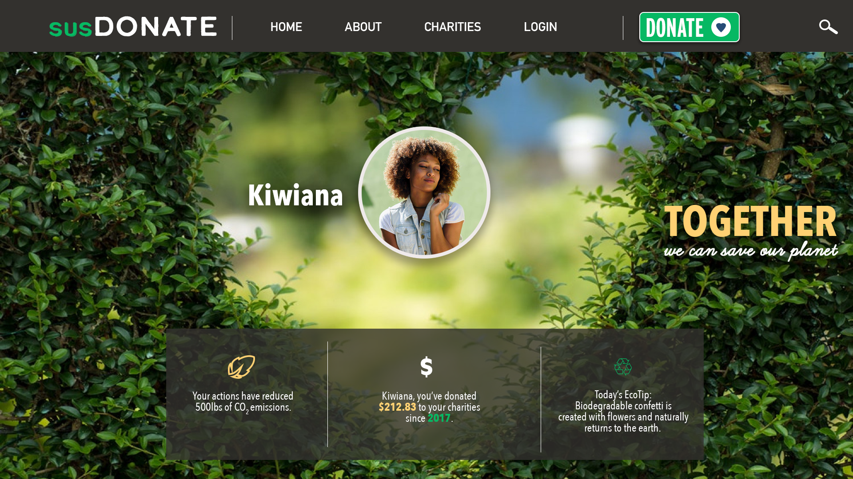

Slide 22
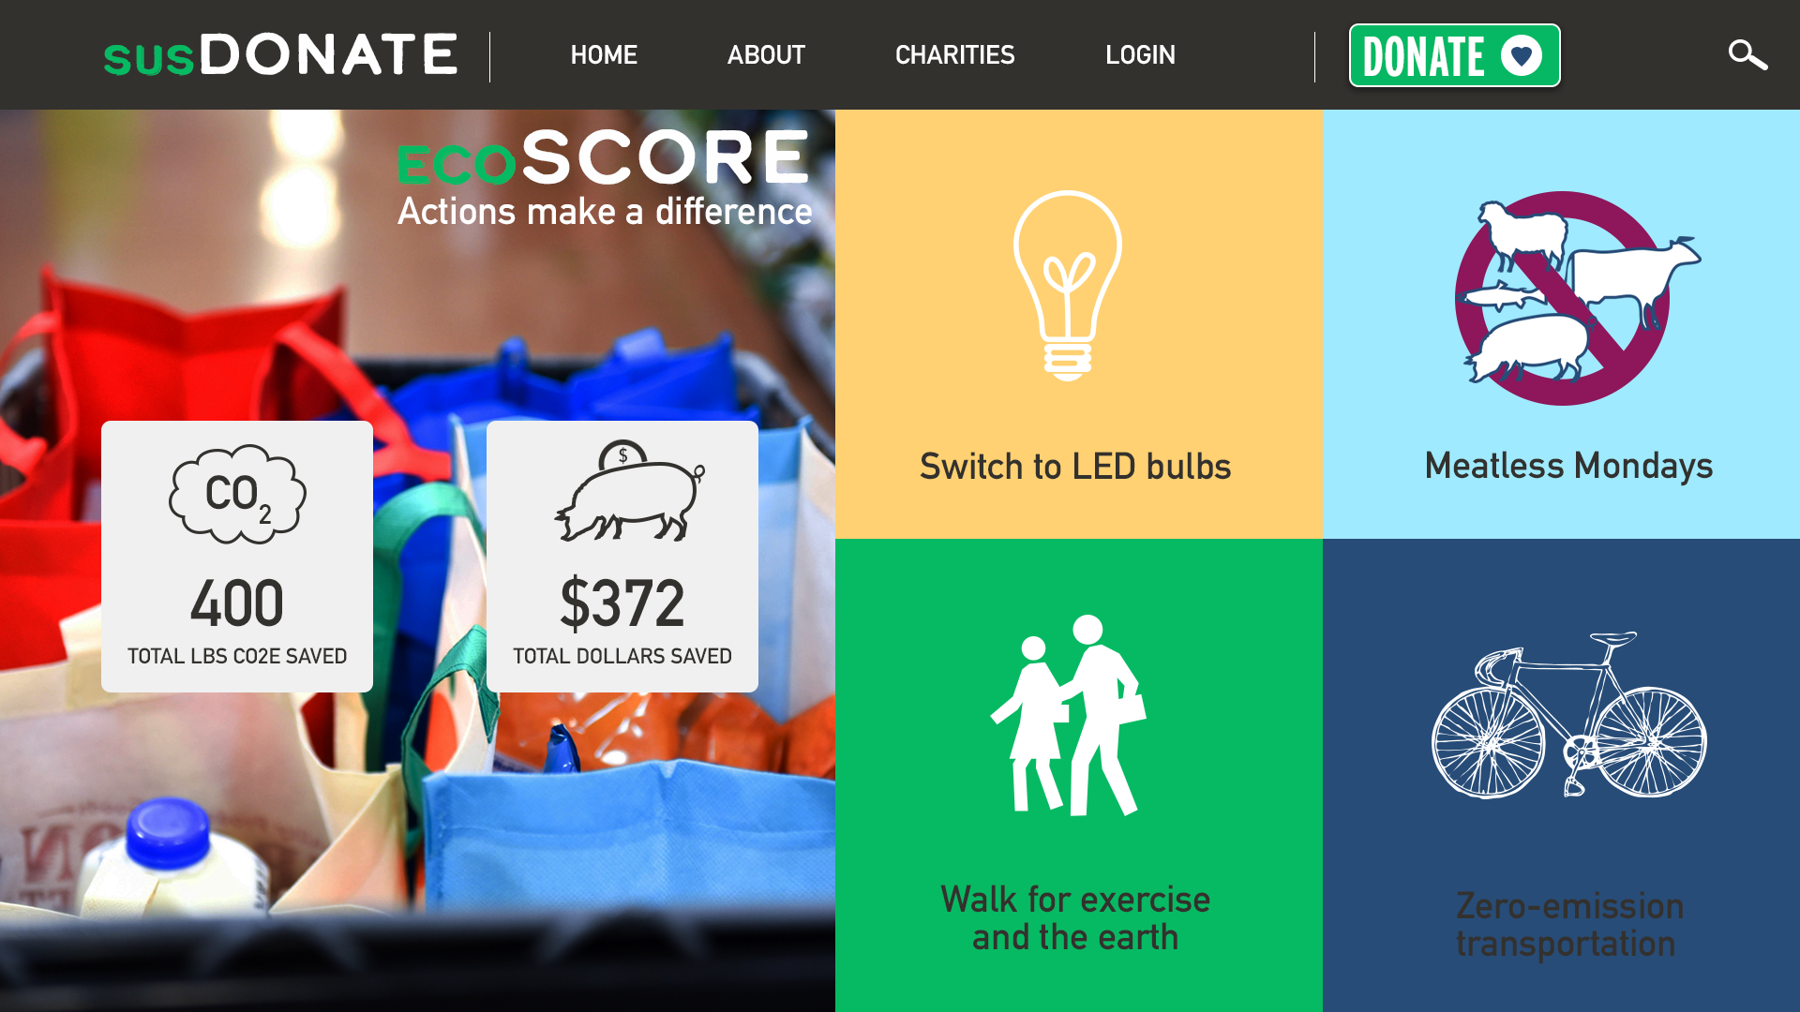

Slide 23
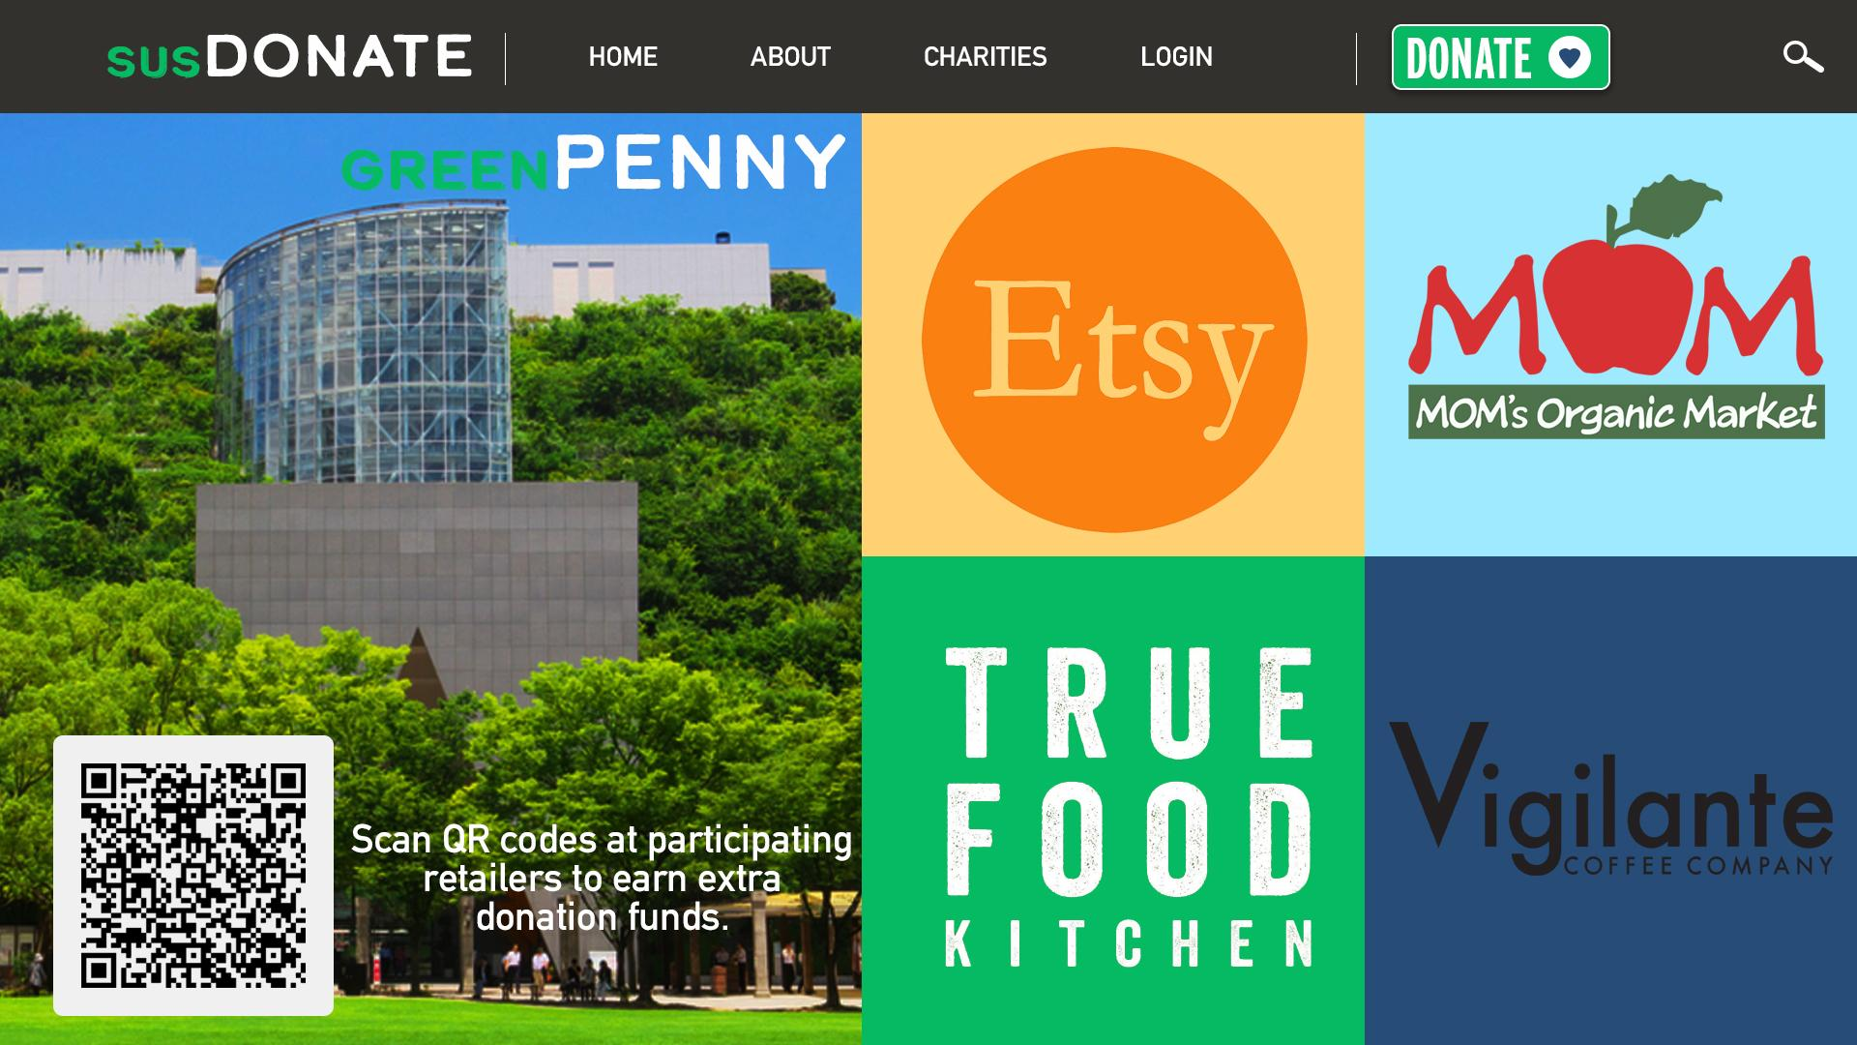

Slide 24
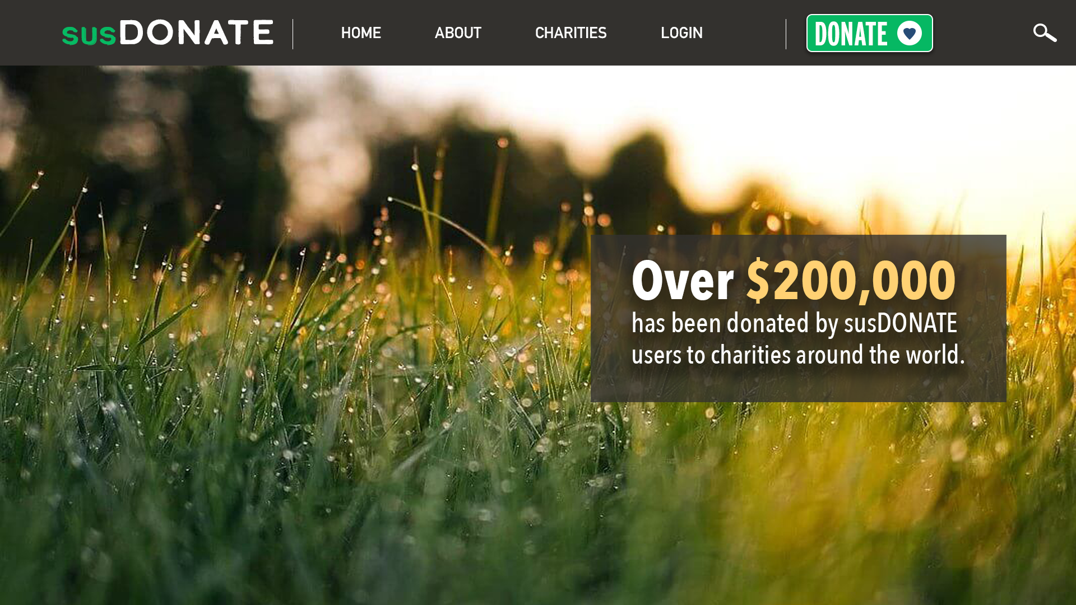

Slide 25
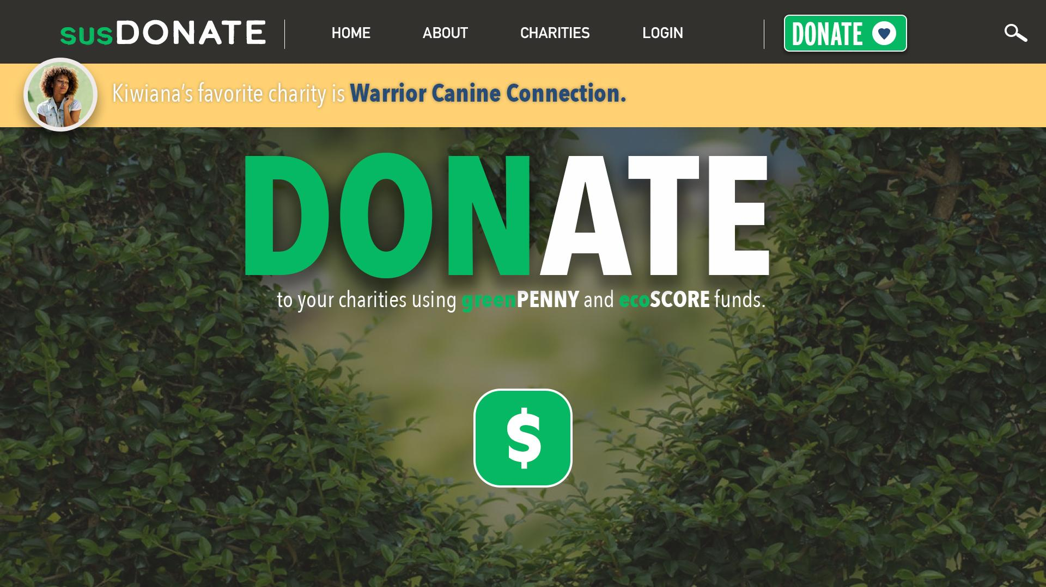

Slide 26
susDONATE GOALS
PAYING FORWARD
INCENTIVIZE SUSTAINABILITY
Monetary rewards are passed to charities that demonstrate sustainability or are positively changing the world.
An application that encourages sustainability by tracking and rewarding environmentally friendly practices.

Slide 27
susDONATE CHANGES THE WORLD
CARBON EMISSIONS
SUSTAINABLE THINKING
EVOLVING CORPORATION PROCESSES
DONATION INCREASES
Better choices reduce carbon emissions and help lower Earth’s temperature.
Tracking individual actions encourages sustainable choices outside of the app.
Data from the QR codes proves to corporations that consumers want sustainable options.
The monies accumulated within the application will lead to an increase in charitable donations.

